Slide 1
RESTRUCTURE
RECONNECT
RETHINK
Leverage Points for Sustainability Transformation
– Institutions, People and Knowledge –
Notes:
1

Slide 2
Presentation Overview
The Sustainability problem setting
Our approach (Leverage Points)
Key challenges
Notes:
As scientists, we tend to shy away from asking fundamental questions about human behavour – these are seen as ideological. We have to ask them! Not as idealogues, but because our interventions thus far have not been effective. Poverty, carbon emissions, biodiversity loss. Despite all our work as sustainability scientists, these remain problems, and are getting worse. For example, we know the climate is changing, we know the general trajectory and have known it since the 1970’s. But we haven’t managed to stop moving along this trajectory.
Meadows, out of frustration at interventions (we understand them) but ineffective. So came up with idea of leverage points.

Slide 3
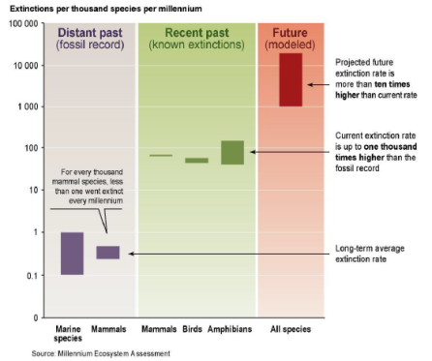
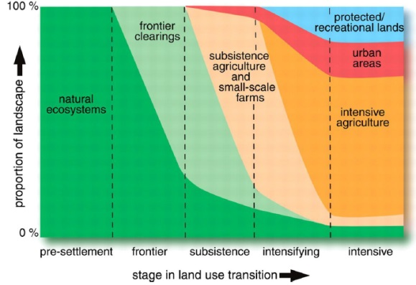
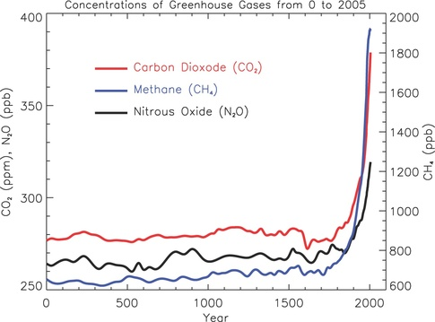
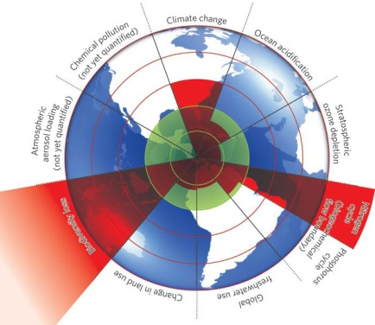
Problem Setting: Rearranging deckchairs…
Frustration at existing sustainability interventions, that don’t appear to effect meaningful change (CAP reform, emissions trading, CBD targets, Millennium Development goals, REDD+).
Short-term
pragmatism
Sustainability deficit
Risk of collapse
Sustainability target
Present
Time
From: Fisher et al. 2007 Mind the sustainability gap
Notes:
As scientists, we tend to shy away from asking fundamental questions about human behavour – these are seen as ideological. We have to ask them! Not as idealogues, but because our interventions thus far have not been effective. Poverty, carbon emissions, biodiversity loss. Despite all our work as sustainability scientists, these remain problems, and are getting worse. For example, we know the climate is changing, we know the general trajectory and have known it since the 1970’s. But we haven’t managed to stop moving along this trajectory.
Meadows, out of frustration at interventions (we understand them) but ineffective. So came up with idea of leverage points.

Slide 4
Problem Setting: Rearranging deckchairs…
Many interventions are treating symptoms not causes
Interventions are often ‘technical adjustments’ rather than systemic changes
Reinforcing (or at least accepting) systems rather than changing them
We need a more systemic understanding of the type of sustainability interventions available
As a departure point we use the framework of Donella Meadows from her paper “Leverage Points” where to intervene in a system” (Meadows, 1999)
Notes:
As scientists, we tend to shy away from asking fundamental questions about human behavour – these are seen as ideological. We have to ask them! Not as idealogues, but because our interventions thus far have not been effective. Poverty, carbon emissions, biodiversity loss. Despite all our work as sustainability scientists, these remain problems, and are getting worse. For example, we know the climate is changing, we know the general trajectory and have known it since the 1970’s. But we haven’t managed to stop moving along this trajectory.
Meadows, out of frustration at interventions (we understand them) but ineffective. So came up with idea of leverage points.

Slide 5
Our approach: Leverage points
Deeper leverage points have great potential, but are under-researched
Current interventions represent ‘shallow’ leverage for systemic change
Current interventions represent ‘shallow’ leverage for systemic change
Design
Redefining goals, information flows and self-organization
Intent
Changing mind-sets
and paradigms
Processes
Changing feedbacks and system rules
Processes
Changing feedbacks and system rules
Material
Altering rewards and material flows
Material
Altering rewards and material flows
High
system
Low
Potential leverage for systemic change
Adapted from Meadows (1999)
Notes:
Meadows identified a hierarchy of increasingly effective leverage points at which to intervene in order to fundamentally change systems.
Existing sustainability “interventions” (e.g. green taxes, biodiversity conventions, regulations, ‘greening’ of the CAP reform etc.) appear to be failing to shift current unsustainable development trajectories? These are easy to change. And easy to engage with as researchers. E.g. look at a carbon price. But deeper leverage points are much harder – fundamentally harder to understand goals and how to change them, or systematic structures – how do we think about or research system change.
Note that deeper leverage point enable or constrain changes at shallower intervention points.
We want to build on transitions research, which is moving in this direction, but rather than just understand how systems have changed, we want to understand how and why opportunities for change can becreated, and to highlight what changes can be made. Active interventions.

Slide 6
Our approach: Three intervention points
RESTRUCTURE (design)
Institutional reform, collapse and renewal, including measures targeting structural or systemic changes
RECONNECT (intent)
Fostering mindful connections between people and ecosystems, both in material and non-material terms
RETHINK (design)
Production and use of knowledge, especially in the context of transdisciplinary processes
Notes:
There are 3 active interventions we are interested in. How to resturucture. How to change connections – spiritual, physical, and impact to management. How to change the type of knowledge and the boundaries within which we think about what knowledge is needed. We have a policy, and scientific rationale about changing incentives and changing efficiencies, or technologies. But if we change that paradigm, what kind of knowledge is needed, and how does it impact upon how knowledge is used? These are all linked – so how does structure which enforces the rules of the system, therefore impact upon knowledge generated within that system. How do we break this rationale?

Slide 7
Our approach: Research levels
Conceptual
Develop a systems based conceptual framework for social-ecological change
Empirical
Detailed multi-dimentional Regional analyses
(food and energy)
Integration
Iterative synthesis across research levels, thematic fields (food and energy) and leverage points (Restructure, Rethink, Reconnect).
Formative accompanying research
Critically reflect on the processes of knowledge production in inter- and transdisciplinary research projects
Transdisciplinary
Deep, participatory, comparative case studies, ground truthing
Notes:
Conceptual challenge and research challenge. How do we do this work.
Develop it then empiricise it and tie into our places.

Slide 8
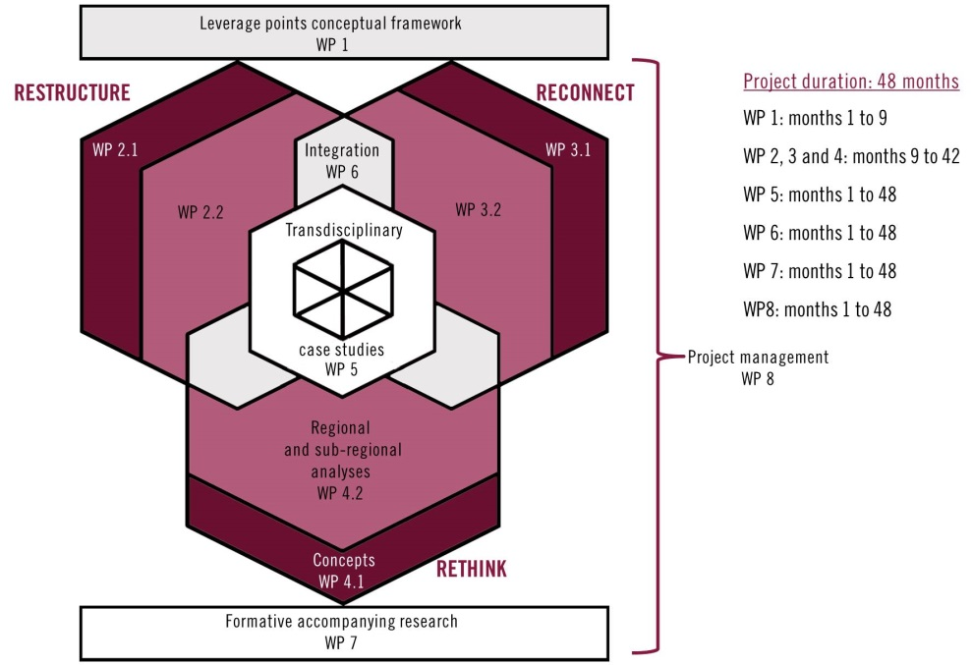
Project Implementation
Our approach: Work packages
Notes:
We know this is ambitious. Develop a group/space for exploration of these concepts.

Slide 9
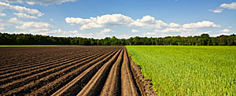
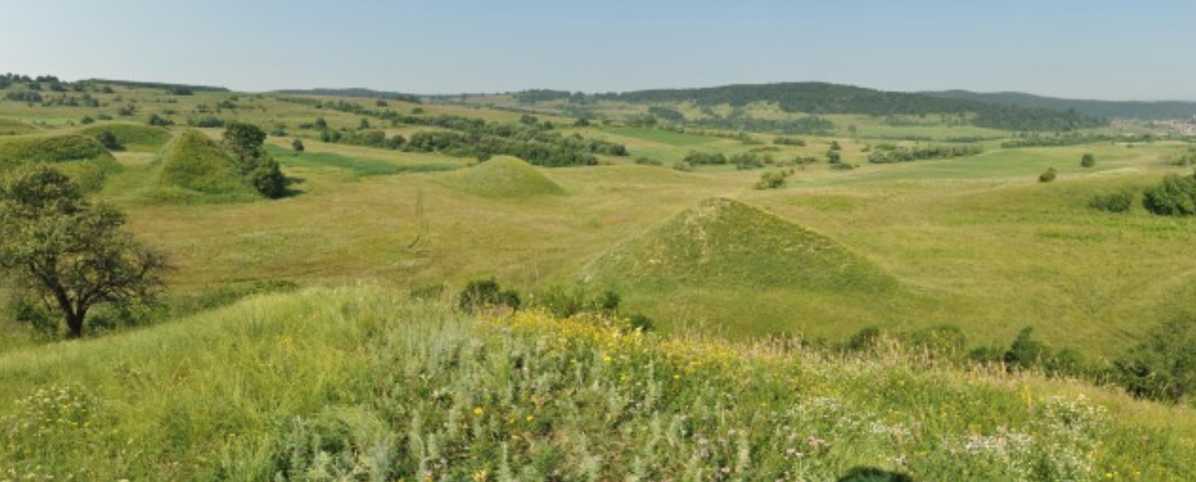
Our approach: Study regions and thematic fields
Food
Energy
Lower Saxony, Germany
Conventional vs. Organic agriculture
Short versus long supply chains etc..
Energy transition (wind, biomass)
Transylvania, Romania
Traditional agriculture is not profitable, intensifcation and abandonment
Fracking as a power source?
Notes:
Ground these concepts into 2 core sustainability issues – food and energy. In real landscapes to concretise the abstract concepts into particular space and place – Lower Saxony and Transylvania. Contrasting systems, but shared parameters (e.g. agricultural, low population, EU structures), but lots of differences in social, economic, political contexts which create good contrasting studies. Interested in governance structure, connections, and knowledge and impacts to sustainability outcomes

Slide 10
Our approach: the dimensions
Reconnect
Restructure
Rethink
The Leverage Points concept:
Shared understanding of the concept, shared terminology, systems boundaries etc..
Integration across dimensions
Conceptual
Empirical
Transdisciplinary
General
Food
Energy
Lower Saxony
Transylvania
Notes:
Conceptual challenge and research challenge. How do we do this work.
Develop it then empiricise it and tie into our places.

Slide 11
Scientific and societal contributions of the project
Our approach: Scientific contributions
Conceptual contribution
  New fundamental insights and frameworks for leveraging sustainable transformations
Empirical contribution
  Detailed synthetic evidence regarding restructuring institutions, enabling knowledge flows and connecting people to their environments.
Transdisciplinary contribution
  concrete local contexts for enacting leverage points, using a solution-oriented, transdisciplinary approach.

Slide 12
Scientific and societal contributions of the project
Key challenges: Conceptual
We need:
A clear understanding by what we mean by “leverage points”
A clear understanding of what we mean by RETHINK, RESTRUCTURE and RECONNECT, how they relate to social-ecological system transformations
To situate these understandings in relation to each other and the broader literature of sustainability science and related disciplines

Slide 13
Scientific and societal contributions of the project
Key challenges: Empirical and Transdiciplinary
We need (informed by our conceptual understanding) to:
Identify in more concrete terms our study regions
Define the bounds of food and energy systems in the study regions
Identify suitable transdisciplinary case studies

Slide 14
Scientific and societal contributions of the project
Key challenges: Integration
We need
Shared understanding across project members and work packages of key notions.

